Slide 1
Principles of International Finance and Open Economy Macroeconomics
Cristina Terra

Slide 2
Chapter 3 The Foreign Exchange Market
Cristina Terra

Slide 3
Plan
The Nominal Exchange Rate
The Goods and Services Market: The Real Exchange Rate
The Assets Market: Interest Rate Parity Conditions

Slide 4
Plan
The Nominal Exchange Rate
What Does Exchange Rate Changes Mean?
What Determines the Exchange Rate?
Can the Government Choose the Exchange Rate?
But, There Are Many Currencies
Nonarbitrage Condition
The Goods and Services Market: The Real Exchange Rate
The Assets Market: Interest Rate Parity Conditions

Slide 5
The Nominal Exchange Rate
Nominal exchange rate = the price for foreign currency.
Why is it such an important price?
The exchange rate is relevant to all importers, exporters, international investors, tourists: all those who trade goods, financial assets or services with other countries.
How is the exchange rate determined?
By the interaction between supply and demand of foreign currency
Registers in the balance of payments:
credits = supply of foreign currency
debits = demand for foreign currency.

Slide 6
The Exchange Rate
The exchange rate is the price relative to two currencies.
A dollar/euro exchange rate $S_{{USD}/{EUR}}=1.3$: one would pay US$1.30 to buy €1.
The corresponding euro/dollar exchange $S_{{EUR}/{USD}}=0.77$: € 0.77 euros are required to purchase US$1.
We have that:
$$S_{{USD}/{EUR}}=\frac{1}{S_{{EUR}/{USD}}}$$
Convention: we usually quote the exchange rate as the price of the foreign currency in terms of the domestic currency

Slide 7
The Nominal Exchange Rate
Exchange rate depreciation, or a depreciation of the domestic currency:
an increase in the price of a foreign currency, which means that the domestic currency is worth less
Exchange rate appreciation, or an appreciation of domestic currency:
a reduction in the price of foreign currency, which implies a higher value for the domestic currency

Slide 8
What determines the exchange rate?
The exchange rate is the price that balances the supply and demand for foreign currency in the exchange rate market.
What would happen if there were as excess supply of foreign currency?
Excess supply of foreign currency = balance of payments surplus
Excess supply of foreign currency => exchange rate appreciation
Cheaper imports and lower revenue from exports
Exports contract and imports increase
Lower balance of payments surplus
The nominal exchange rate is then the rate compatible with equilibrium in the balance of payments.

Slide 9
Can the government choose the exchange rate?
The government can intervene directly in the exchange rate market, buying and selling foreign currency, and affect its price.
For instance, the government may sell foreign currency to maintain an appreciated exchange rate.
The government can also indirectly affect the exchange rate by using economic policies to stimulate private agents to increase or decrease their demand for foreign currency.
For example: contractionary monetary policy => higher domestic interest rates => domestic financial assets become more attractive to foreign investors => capital inflow = increase in the supply of foreign currency => exchange rate appreciation.

Slide 10
But, there are many currencies...
There are 164 currencies in the world, but each country transacts with only a limited number.
Countries usually negotiate in the currency of their main trade partners and currencies commonly used in the world, which are used as currency vehicles.
The main vehicle currencies are the dollar, euro, yen and sterling pound.

Slide 11
Non-Arbitrage Condition
The international exchange rate market is composed of many agents ready to take advantage of any eventual possibility for arbitrage, which is a transaction that takes advantage of price differences in order to profit.
Example
Suppose $S_{EUR/USA}^{FR}>\frac{1}{S_{USA/EUR}^{USA}}$
A bank could transfer US$1 from the United States to France, and with this dollar it would buy $S_{EUR/USA}^{FR}$ euros
Next, it would transfer the euros to the United States and exchange them for $S_{EUR/USA}^{FR}×S_{USA/EUR}^{USA}>1$ dollars, thus making a profit.
This arbitrage performed by many agents causes an increase in the supply of dollars in France, decreasing its price. At the same time, the supply of euros in the USA increases, also pressuring down its price.
In equilibrium, we have that: $S_{EUR/USA}^{FR}=\frac{1}{S_{USA/EUR}^{USA}}$

Slide 12
Plan
The Nominal Exchange Rate
The Goods and Services Market: The Real Exchange Rate
The Law of One Price and Purchasing Power Parity
The Assets Market: Interest Rate Parity Conditions

Slide 13
The Goods and Services Market: The Real Exchange Rate
The exchange rate between the Kazakhstan tenge and the Nepal rupee was about 1.80 in August 2014.
Was the rupee cheap or expensive for the Kazakhs?
If a Kazakh is interested in taking a vacation in Nepal, they will compare prices in Nepal, converted into tenges by the exchange rate, with the prices in Kazakhstan.
If our interest is to consume goods and services in another country, we compare prices in the two countries by converting them into the same currency by using the exchange rate.

Slide 14
The Real Exchange Rate
The real exchange rate measures the relative price of goods between the two countries:
$$Q≡\frac{SP^{∗}}{P}$$
Depreciation of the real exchange rate: the purchasing power of the domestic currency decreases (Q increases)
Appreciation of the real exchange rate: an increase in purchasing power of the domestic currency (Q decreases)

Slide 15
The Real Exchange Rate
The real exchange rate measures the incentive our Kazakh has to purchase local goods or to import them from Nepal.
But, actually, Kazakhstan trades very little with Nepal.
We can calculate the real exchange rate between Kazakhstan and all its trade partners.
This measure is the real effective exchange rate (REER), or the multilateral exchange rate, defined as:
$$Q^{F}≡\prod_{i∈I}{{\left(\frac{SP^{i}}{P}\right)}^{w^{i}}}$$
where $w^{i}≡\frac{X^{i}+M^{i}}{\sum_{j∈I}{\left(X^{j}+M^{j}\right)}}$

Slide 16
The Law of One Price
If there were neither transportation costs nor any trade barriers, the price of a good should be the same in both countries, when measured in the same currency.
This would be the Law of One Price:
$$SP_{b}^{∗}=P_{b}$$
where $P_{b}$ and $P_{b}^{∗}$ is the price of good b in the domestic and foreign country

Slide 17
The Purchasing Power Parity
If the price index is calculated in exactly the same way in the countries, and if there are no international trade costs for any good, the purchasing power of the currency in both countries should be identical.
This condition is known as Absolute Purchasing Power Parity (Absolute PPP), described as:
$$\frac{SP^{∗}}{P}=1=Q=Q^{F}$$
The real exchange rate is always constant and equal to 1.

Slide 18
PPP: transportation costs
The PPP is based on very strong hypotheses.
PPP is frequently violated: prices are not equal between countries.
One reason: transportation costs and trade barriers
With costs associated with international trade, there can be a difference in prices, not higher than transportation costs, as in:
$$\frac{1}{1+τ}≤\frac{SP_{b}^{∗}}{P_{b}}≤1+τ,$$
and the RER:
$$\frac{1}{1+τ}≤Q^{F}≤1+τ$$

Slide 19
PPP: Non-Tradables
There are goods that simply cannot be transported (example: Land)
There are other goods for which transportation costs are so high in relation to price that they are not worth transporting (example: haircut)
These goods are referred to as non-tradable.
There is no limit for price differences in non-tradable goods between countries.
The fact that the goods baskets contain non-tradables could be a reason for the PPP not being valid.

Slide 20
PPP: Differentiated Goods
There are also differentiated goods.
These are goods that are substitutable between themselves – all automobiles have the same function – but that are not perfect substitutes being that automobiles manufactured by different companies have their own characteristics.
Due to this, the price of these goods can be different, and this difference affects their relative demand.
The existence of differentiated goods could be another reason for the non-validity of the PPP, even for tradable goods.

Slide 21
PPP: Differences in Preferences
The price indexes used in empirical work are not always computed the same in different countries.
The consumer price index, for example, is computed according to the aggregate consumption basket of the country.
If goods are consumed in different proportions in different countries, the composition of the index will not be the same.
The divergence in relation to the PPP could simply refer to the fact that the comparison is being made between very different baskets of goods

Slide 22
PPP and RER
Even if not equal to 1, the RER should be at a level compatible with equilibrium in the economy.
Each RER level is associated to a trade balance value.
The equilibrium RER depends on variables that affect the equilibrium level of the current account or that affect the relationship between the real exchange rate and the current account:
the productivity in tradable and non-tradable sectors, the terms of trade, government expenditure, the level of indebtedness of a country, among others.

Slide 23
Relative PPP
When the real exchange rate is at its equilibrium level, and the variables that determine this level do not vary, the relative purchasing power parity (Relative PPP) should hold true:
$$\dot{s}\left(t\right)=π\left(t\right)−π^{∗}\left(t\right)$$
where $\dot{s}\left(t\right)≡\frac{d\text{lnS}\left(t\right)}{dt}=\frac{{d\text{S}\left(t\right)}/{dt}}{\text{S}\left(t\right)}$ , $π\left(t\right)≡\frac{{dp\left(t\right)}/{dt}}{p\left(t\right)}$ and $π^{∗}\left(t\right)≡\frac{{dp^{∗}\left(t\right)}/{dt}}{p\left(t\right)}$.
The relative PPP implies an ever-constant real exchange rate, but not necessarily equal to 1.

Slide 24
Plan
The Nominal Exchange Rate
The Goods and Services Market: The Real Exchange Rate
The Assets Market: Interest Rate Parity Conditions
Carry Trade
Covered Interest Rate Parity
Risk Premium
Uncovered Interest Rate Parity
The Peso Problem

Slide 25
The Financial Assets Market: Interest Rate Parity Conditions
What if someone is considering buying financial assets?
Comparing the return of a German and an American assets
German asset: investing €1 earns €$\left(1+{\text{i}}_{t}\right)$ for the next period.
American asset: with €1, one buys US$$\frac{1}{S_{t}}$ ($S_{t}$ = euro/dollar exchange rate)
The asset yields the American interest rate $i_{t}^{∗}:$ US$$\frac{1}{S_{t}}\left(1+i_{t}^{∗}\right)$.
Converted back into euros: $€\frac{{}_{t}^{}{F_{t+1}}}{S_{t}}\left(1+i_{t}^{∗}\right)$ (at the time of purchase, the investor buy euros in the forward exchange market to convert the return back into euros at the time of redemption)
In sum: $€1\underset{→}{converts}US\$\frac{1}{S_{t}}\underset{→}{\text{invests}}US\$\frac{1}{S_{t}}\left(1+{\text{i}}_{t}^{∗}\right)\underset{→}{\text{converts} \text{back}}€\frac{{}_{t}^{}{F_{t+1}}}{S_{t}}\left(1+{\text{i}}_{t}^{∗}\right)$

Slide 26
The Financial Assets Market: Interest Rate Parity Conditions
The difference in returns between the two assets, $DIFF$, is therefore:
$$DIFF≡\left(1+i_{t}\right)−\frac{{}_{t}^{}{F_{t+1}}}{S_{t}}\left(1+{\text{i}}_{t}^{∗}\right)$$
The return differential is one of the criteria used by investors to decide which asset to purchase.
The American and German assets can also differ in relation to their liquidity or the risk associated with them
In this way, the higher the relative return of the American asset, the higher its attractiveness will be in relation to the German, and, consequently, the higher its demand will be.

Slide 27
The Financial Assets Market: Interest Rate Parity Conditions
If, however, the German and American assets in question neither differ in relation to risk nor liquidity, the only difference between them is their return.
With free capital mobility, a difference in the assets returns will lead investors to allocate all available wealth to invest in the asset with the higher return.
Hence, the non-arbitrage condition implies the same return for German and American assets:
$$\frac{{}_{t}^{}{F_{t+1}}}{S_{t}}\left(1+{\text{i}}_{t}^{∗}\right)=\left(1+i_{t}\right)$$

Slide 28
Covered Interest Parity Condition
Reorganizing the previous equation, we have the covered interest rate parity condition:
$$\frac{{}_{t}^{}{F_{t+1}}}{S_{t}}=\frac{1+i_{t}}{1+i_{t}^{∗}}$$
This parity condition is called covered since it is covered for the exchange risk.
It is commonly written in log, as in:
$${}_{t}^{}{f_{t+1}}−s_{t}=i_{t}−i_{t}^{∗}$$
where: $s≡\text{ln}\left(\text{S}\right)$, $f≡\text{ln}\left(F\right)$ e $i≡\text{ln}\left(\text{1+}\text{i}\right)$.

Slide 29
Covered Interest Parity Condition
For an investor, it is not the exchange rate that matters, but its variation over time.
A variation in the exchange rate between the time of buying and selling of a foreign asset alters the value of the foreign asset in domestic currency.
There are two crucial assumptions for the covered interest rate parity to hold true:
free capital mobility and
perfect substitutability of assets.

Slide 30
Covered Interest Parity Condition
Even if there is perfect mobility of capital, there can be differences in return between assets if they are not perfect substitutes.
The differences in their return reflect differences in their relative attractiveness. For instance: differences in risk
Credit risk evaluation agencies, such as Standard & Poor’s and Moody’s, that attribute credit risk ratings to countries, companies and banks.

Slide 31
CIP and Risk Premium
Countries with a higher credit risk should supply a higher yield on their assets to compensate investors for the risk incurred.
The term risk premium refers to this increase in return associated with the ability to pay of the issuer of the asset.
The covered interest rate parity, taking into account the sovereign risk, can be written as:
$$i_{t}−i_{t}^{∗}−\left[{}_{t}^{}{f_{t+1}}−s_{t}\right]=∅_{t}^{s},$$

Slide 32
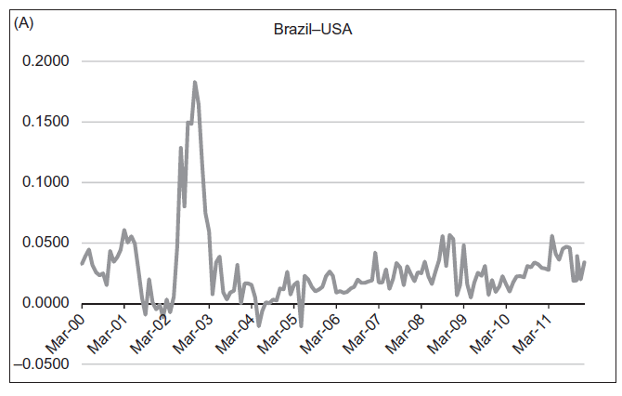
Risk Premium: Brazil vs. USA

Slide 33
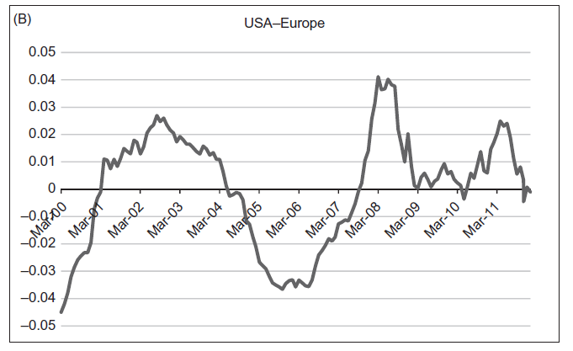
Risk Premium: USA vs. EUROPE

Slide 34
Uncovered Interest Rate Parity
Investors may opt to arbiter between the return of two assets without resorting to the future exchange market.
In this case, the non-arbitrage condition is uncovered interest rate parity condition:
$$\frac{E\left(S_{t+1}\right)}{S_{t}}=\frac{1+i_{t}}{1+i_{t}^{∗}}$$
The term uncovered refers to the fact that the transaction is not covered for the exchange risk.
Taking the logarithm, we have the UIP in log:
$$E\left(s_{t+1}\right)−s_{t}=i_{t}−i_{t}^{∗}$$

Slide 35
Uncovered Interest Rate Parity
If there is no exchange rate risk premium, we have that:
$${}_{t}^{}{f_{t+1}}−s_{t}=E\left(s_{t+1}\right)−s_{t}$$
the CIP and the UIP are equivalent.
If CIP is verified =>there is perfect capital mobility across countries and the assets are perfect substitutes.
If CIP is verified but the uncovered not => there is a risk premium in the exchange rate change in the future market:
$${}_{t}^{}{f_{t+1}}−s_{t}=E\left(s_{t+1}\right)−s_{t}+∅_{t}^{c}$$
The interest parity conditions becomes:
$$i_{t}−i_{t}^{∗}−\left[E\left(s_{t+1}\right)−s_{t}\right]=∅_{t}^{c}$$

Slide 36
The Peso Problem
In principle, there are no exchange rate depreciations, under a fixed exchange rate regime.
However, there can be an expectation of depreciation if there is uncertainty in regards to maintaining the regime.
Let $λ$ be the probability agents attribute to the maintenance of the fixed exchange rate $\overline{s}$.
If the fixed exchange rate regime is abandoned, the exchange rate becomes $\hat{s}>\overline{s}$.
The expected exchange rate is then:
$$E\left(s_{t+1}\right)=λ\overline{s}+\left(1−λ\right) \hat{s}.$$

Slide 37
The Peso Problem
The error in exchange rate expectation :
$$E\left(s_{t+1}\right)−s_{t}=λ\overline{s}+\left(1−λ\right) \hat{s}−\overline{s}$$
$$E\left(s_{t+1}\right)−s_{t}=\left(1−λ\right)\left(\hat{s}−\overline{s}\right)>0$$
Hence, there are persistent and biased expectations errors.
This simple example shows that, even when expectations are perfectly rational, there can be persistent errors in exchange rate expectations when there is a probability of regime change. This is called the peso problem

Slide 38
The Peso Problem in Argentina
Between 1991 and 2002, Argentina adhered to a currency board regime: fixed Argentine peso/dollar exchange rate.
The interest rate differential between the two countries, however, changed considerably over the period.
In the first years of the regime, the interest rate differential between Argentina and the United State was high: the lack of credibility at the onset of the regime.
As of the end of 1999, when external shocks put in check the possibility of maintaining the regime, Argentine interest rates again began distancing themselves from the American.

Slide 39
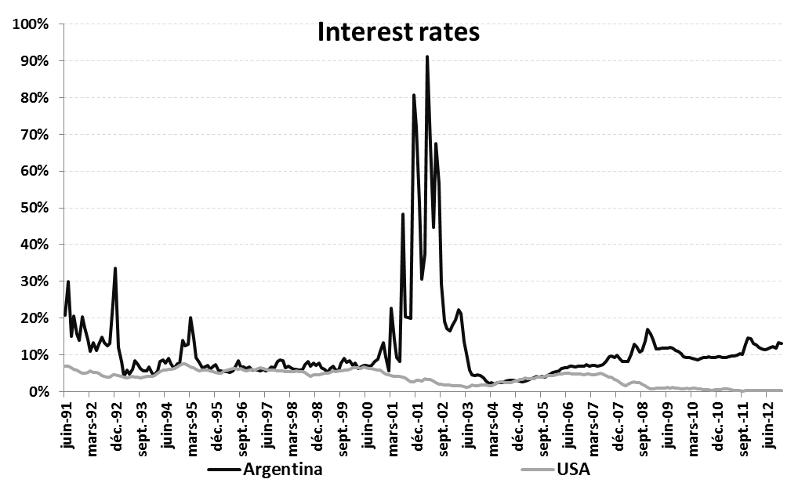
The Peso Problem in Argentina

